Slide 1
Augmented Reality Presentation
Apk @ https://goo.gl/RbJ6mJ

Slide 2
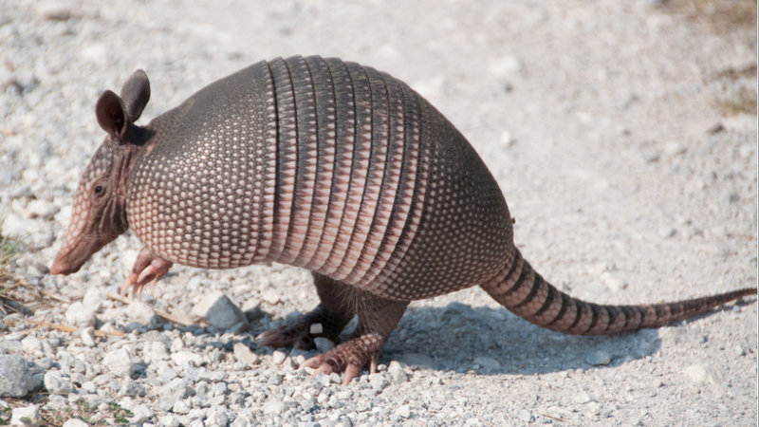
Armadillo

Slide 3
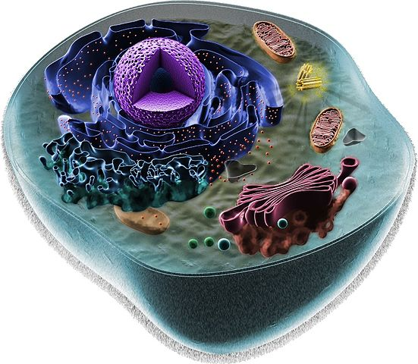
Animal Cell

